Slide 1
透過 Microsoft Power BI 將資料融入 生活
Notes:
Welcome to this presentation!

Slide 2
01 Power BI 簡介以及 Power BI 家族
新一代商業智慧 (BI, Business Intelligence)
認識 Microsoft Power BI
Power BI 功能概觀
開始使用 Power BI
Notes:
Introduce the module title and topics.

Slide 3
新一代的商業智慧 (BI) 工具
時至今日, 每個人都需要 BI
3rd wave 用戶型 BI
每個人自行操作
2nd wave 自助式 BI
由分析師提供
1st wave 技術型 BI
由 IT 人員提供
Notes:
Key message:
Business intelligence, or BI, has come a long way.
During the first two waves of business intelligence, IT professionals and business analysts were the keepers of BI. They made BI accessible and consumable for end users.
While this approach still applies to complex business intelligence needs, today there is a new wave.
This third wave of BI makes BI available to every kind of user.
Talking points:
Today we’re going to discuss Power BI, which is a third-wave solution. Power BI enables EVERYONE to collect, analyze, visualize and publish data.
This third wave has the potential to expand the reach of analytics to more users than ever before. Existing analytics platforms and tools can be extended, instead of being replaced, by full-featured solutions like Power BI. Power BI directly connects to existing on-premises data, such as Analysis Services tabular models that were created by business analysts in collaboration with IT. Microsoft Excel and the new Power BI Desktop work hand-in-hand with Power BI, publishing reports and models created by business analysts and getting them more easily in the hands of the business users who can gain insight and take action.

Slide 4
新一化的商業智慧 (BI) 工具
將資料轉換成商業洞察 (business insights) 很有挑戰性
常見的 BI 挑戰包括了…
端至端的視野
資料經常散落在各地，如果想要看到整個商業全貌就會有點麻煩
多重資料來源
有些資料儲存在 SaaS 服務中，或是其它外部地點，若要安全地經常更新資料也會很麻煩
在對的時間將對的資料呈現給對的用戶
不同的角色有不同的需要，而做商業決策的人可能需要最新的資料
Notes:
Power BI addresses three common business intelligence challenges that an organization may face:
Getting an end-to-end view off what is happening — because data is often in disparate locations, it can be difficult for business users to see a complete picture of your business
Managing multiple data sources — Data residing in SaaS solutions and other external locations can be difficult to manage programmatically, or access and refresh securely
Making the right data available to the right users at the right time
Mobile business users need the latest operational data at their fingertips, no matter where they are or what device they’re using
Different roles have different needs and access levels, so a one-size-fits all solution doesn’t work

Slide 5

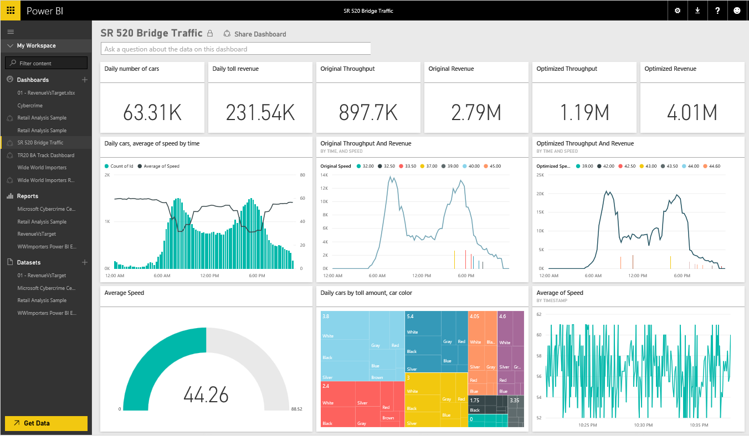
認識 Microsoft Power BI
重新認識你的資料，不論它們是哪種形式…
Power BI 是一個以雲端為基礎的商業分析服務，它讓用戶能夠:
快速且容易存取到資料
即時檢視 360º 的商業面貌
發現及探索資料的內涵
從任何裝置中讀取洞察結果
在組織間共享文件
任何人都能輕易視覺化或分析資料
Power BI
Notes:
Key message:
Power BI is a business analytics service. With Power BI you can now see all of your data through a single pane of glass. Live Power BI dashboards and reports show visualizations and KPIs from data residing both on-premises and in the cloud, providing a consolidated view across your business regardless of where your data lives.
Talking points:
This is Power BI in a nutshell and the overall benefits to your business. We will look at what this means for the IT Pro and the key benefits for IT on the next slide

Slide 6

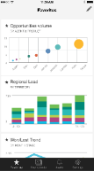
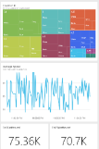
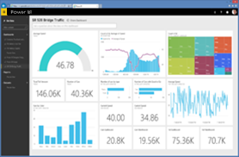
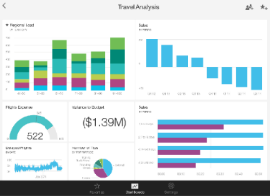
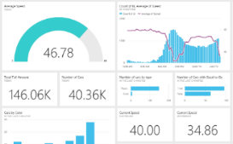

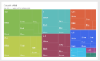
認識 Microsoft Power BI
主要特色及差異化
內建由知名 SaaS 服務所組成儀表板、報表的內容套件
即時儀表板更新
安全、即時連結您的資料來源，不論是在自家機房還是在雲端平台
使用自然語言查詢直觀的資料探索
與熟悉的微軟產品整合，並且透過 Azure 得到延展性及可得性
快速部署、混合式設定、安全並且與既有的 IT 系統整合
Notes:
Key message:
There are several capabilities that differentiate Power BI from other offerings in the market.
Talking points:
Power BI is a cloud-based analytics service that provides faster time to insight. It is used for visualizing, exploring and extracting insights from data. It brings together data from diverse sources to deliver rich, comprehensive views of business operations.
What that means is, with Power BI, you can see all of your data through a single pane of glass, and create an analytics environment in minutes to monitor data and share reports. Live dashboards and reports show visualizations and KPIs from data that reside both on-premises and in the cloud, providing a consolidated view across your business regardless of where your data lives.
There are several capabilities that are unique to Power BI – these include:
Pre-built dashboards and reports for popular SaaS solutions such as Marketo, Salesforce, GitHub, ZenDesk, Dynamics CRM, and many others
Dashboards and visualizations that support real-time updates
Secure, live connection to on-premises data sources to drive insight across the entire range of organizational information (Analysis Services, Azure SQL Database, SQL Database Auditing, Azure SQL Data Warehouse)
Automated scheduled refresh to keep your Power BI data in sync with on premises data sources
Native mobile applications for keeping users connected on the go
Easy integration with other Microsoft offerings, from Excel to Azure services
Intuitive data exploration, which enables users to ask questions of their data in plain English
To summarize, Power BI is a SaaS offering that enables anyone to easily connect to their data, create live operational dashboards and explore data via interactive visualizations

Slide 7


Power BI 概觀
資料來源
Power BI 服務
SaaS 解決方案
E.g. Marketo, Salesforce, GitHub, Google analytics
內容套件
自然語言查詢
分享與協作
傳統機房內的資料
E.g. Analysis Services
即時儀表板
組織的內容套件 Corporate data sources, or external data services
視覺化
Azure 服務
E.g. Azure SQL, Stream Analytics
報表
Excel 檔案
Workbook data or data models
01001
10101
Power BI Desktop 檔案
Related data from files, databases, Azure, and other sources
資料集
資料更新

Slide 8

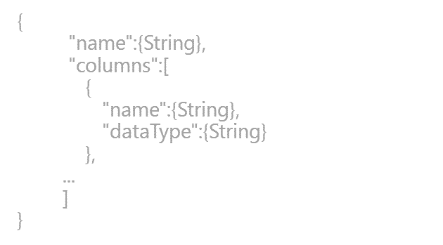
Power BI 概觀
SaaS 解決方案
E.g. Marketo, Salesforce, GitHub, Google analytics
內容套件
自然語言查詢
分享與協作
傳統機房內的資料
E.g. Analysis Services
即時儀表板
組織的內容套件 Corporate data sources, or external data services
視覺化
Azure 服務
E.g. Azure SQL, Stream Analytics
Excel 檔案
Workbook data and data models
報表
01001
10101
Power BI Desktop 檔案
Related data from files, databases, Azure, and other sources
資料集
0110001
00010110
資料更新
Power BI Desktop
Power BI REST API
準備
探索
報表
分享
Notes:
Let’s walk through an overview of how Power BI works.
1. The Power BI service, sometimes referred to as powerbi.com, is what allows you to:
Create beautiful visualizations to tell compelling data stories
Build rich, live dashboards that turn BI into business insights
Create reports & datasets from which you can create visualizations and dashboards
Enjoy the benefits of up-to-date data with real-time, automatic and scheduled refreshes
Share dashboards easily with other people in your organization
Ask questions of data in plain English with Natural Language Query
Stay connected to your data all the time with mobile applications
2. Power BI connects to a variety of data sources. These range across both cloud and on-premises sources, and include:
A variety of popular SaaS solutions, such as Marketo, Salesforce, GitHub, Dynamics CRM, Zendesk, and several others
On-premises databases – Power BI offers live connectivity to SQL Server Analysis Services, which we’ll cover in more detail later. And using a gateway solution, Power BI can connect to other database solutions.
Custom data sources – Power BI can connect to any data source you need it to thanks to its extensibility via REST APIs. This includes both proprietary corporate data sources, as well as external data services. For example, if you are a SaaS solution provider, you can work with Microsoft to connect your solution to Power BI.
Other Azure services – Power BI integrates tightly with SQL Azure and Stream Analytics, and will be integrating closely with more Azure services over time
Power BI Desktop and Excel files – Excel workbooks can be directly connected to Power BI.com, or may be used with Power BI Desktop. Power BI Desktop is a companion application to the Power BI service – it is a desktop tool that supports data analysis and reporting. Like Excel files, Power BI Desktop files may be uploaded to the Power BI service.

Slide 9
Power BI 概觀
不論身處何種產業、擔任何種職位，Power BI 都與您有關
商務人士
從 SaaS 服務中匯入資料，並且操作報表及儀表板
商業分析師
Import, reshape, integrate and model data
Create compelling reports and visualizations
Create content packs to share insights
BI professional
Connect to live Azure data services
Connect to on-premises Analysis Services databases
Empower colleagues to create their own reports
Developer
Integrate applications with Power BI
Create real-time dashboards
Develop custom visuals
Notes:
This slide can be used to categorize the Power BI features into different roles.
During this course, different topics will be relevant to different roles – so it is good to define these early on.

Slide 10
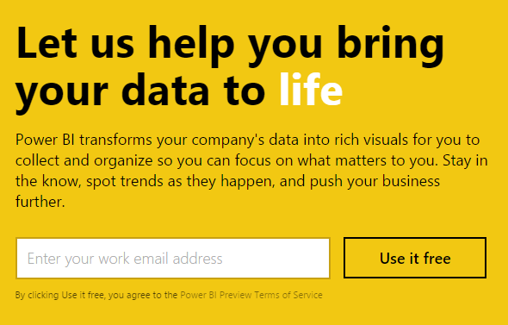
開始使用 Power BI
免費註冊、幾秒內就能開始使用
Power BI 僅支援公司、組織或學校的帳號
Notes:
Key message:
Get started quickly with the Power BI service (powerbi.com) for faster decision-making by displaying all of your data in one place
Talking points:
As discussed earlier, you can get started quickly with pre-built content packs for popular SaaS solutions
The primary capability of Power BI is that it empowers you to create and customize live dashboards – dashboards that include visualizations from multiple data sources
That is, dashboards can show different types of data from a variety of sources, and can use a range of unique visualizations
If applicable, you can track status in real-time thanks to support for real-time data sources
You have full control over your dashboards – pin any visualization from any report to any dashboard
Click through visualizations to access their underlying reports to discover more data and new insights

Slide 11
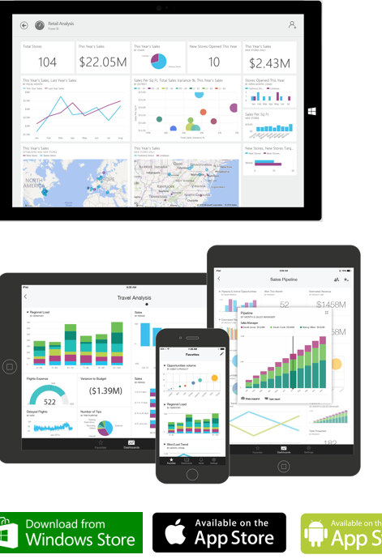
行動裝置應用程式
在您的行動裝置上，使用原生的應用程式來存取儀表板，支援：
Windows
iOS (iPhone and iPad)
Android
行動應用程式的功能：
針對重要的視覺化圖表設定最愛
縮放檢視視覺化圖表
在圖表上標記並分享給其它人
針對關鍵的商業指標設定警示或通知
Notes:
Power BI Knowledgebase:
https://support.powerbi.com/knowledgebase/topics/75729-power-bi-app-for-windows
https://support.powerbi.com/knowledgebase/topics/78002-iphone-app-power-bi-for-ios
https://support.powerbi.com/knowledgebase/topics/85887-power-bi-app-for-android-phones

Slide 12
02 認識並建立資料集
內容套件
連接資料來源
DirectQuery
Notes:
Introduce the module title and topics.
It is recommended that you become fully familiar with the module content by researching the topics at the Power BI knowledgebase: https://support.powerbi.com/knowledgebase - many links are provided in the presenter notes.

Slide 13

從 Power BI 連接資料來源
從 Power BI 中連接資料很簡單，並且支援多種不同的格式:
內容套件:
從我的組織
網路服務
檔案，包括:
Power BI Desktop 檔案
Excel 工作簿
資料庫及資料服務 – 同時包含雲端平台及傳統機房
Notes:
Power BI Knowledgebase:
https://support.powerbi.com/knowledgebase/topics/63369-get-data
https://support.powerbi.com/knowledgebase/topics/88767-files-in-power-bi

Slide 14
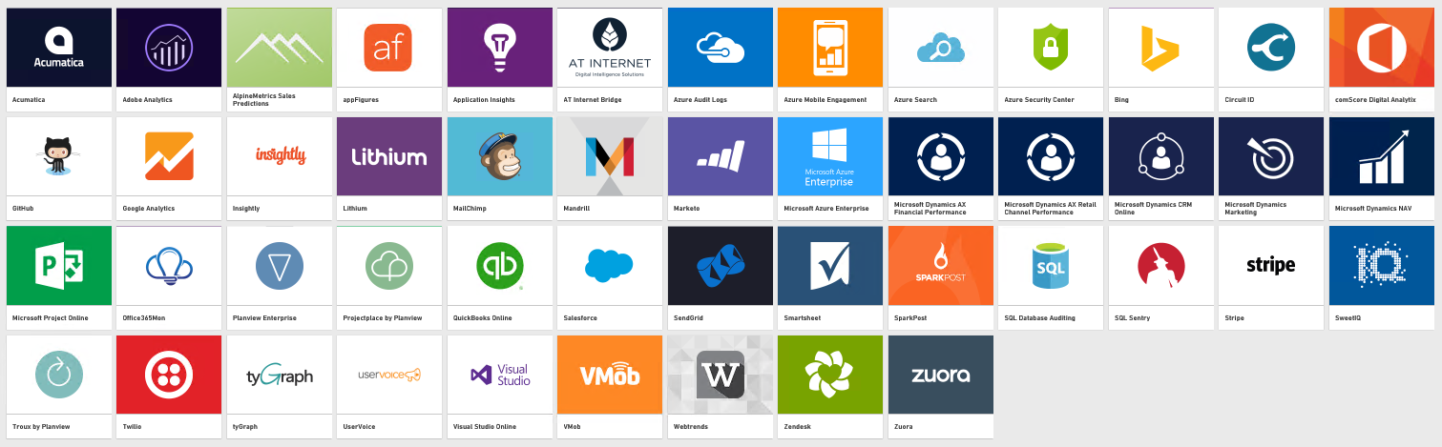
從 Power BI 連接資料來源
格式: 內容套件: SaaS 應用程式
Power BI 能夠連接 SaaS 應用程式
必須原本就擁有帳號
每個內容套件提供預先建立好的儀表板及報表
* 至 2016 年 3 月為止
持續增加中!

Slide 15
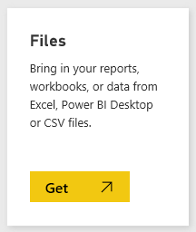
從 Power BI 連接資料來源
格式: 檔案
透過上傳、或是連接至商務用 OneDrive 或個人用 OneDrive 來存取檔案資料
在 OneDrive 上檔案內容若有更新，儀表板及報表上的資料也會自動更新
支援的檔案類型:
Power BI Desktop 檔案
Excel 工作簿
CSV 檔案
檔案大小上限: 250MB

Slide 16
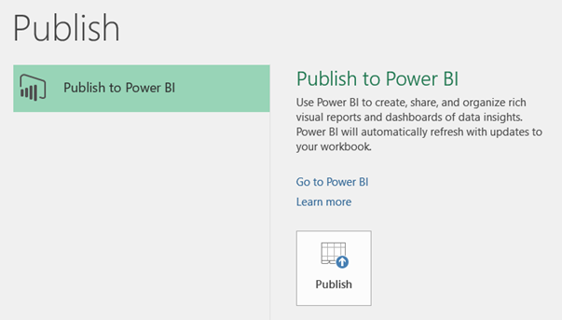
從 Power BI 連接資料來源
格式: 檔案: Excel 2016
Excel 2016 可以直接發佈至 Power BI 服務
發佈必須透過商務用 OneDrive
從 Excel 2016 更新資料內容也會反映在 Power BI 資料集中

Slide 17
從 Power BI 連接資料來源
格式: 檔案: Power BI 名稱轉換
Power BI Desktop 檔案:
檔案 ► Power BI 資料集
報表 ► Power BI 報表
An empty dashboard is automatically created, with a token tile to connect to the dataset (i.e. Q&A ready)
Excel 工作簿:
Data model content takes precedence over worksheet content
Workbook data model ► Power BI dataset
Power View sheets ► Pages of a Power BI report
PivotTables, PivotCharts and custom fields are not recognized

Slide 18
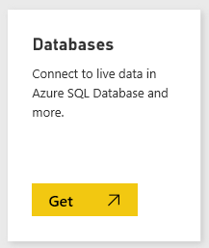
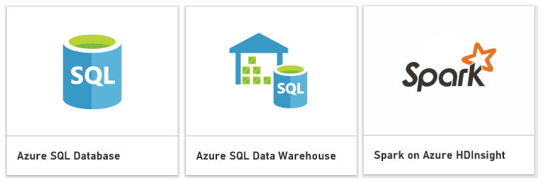
從 Power BI 連接資料來源
格式: 資料庫及資料服務
透過 direct connect 功能連接，特定 Azure 服務
回到 Azure 上進行查詢並回傳資料 (儀表板上的磚每 15 分鐘更新)
These experiences are intended for users who are familiar with the databases and entities they connect to
必須要用 Power BI Pro 授權才能使用

Slide 19
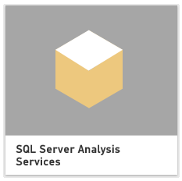
從 Power BI 連接資料來源
Formats: Database and data services: SQL Server Analysis Services
Live connections to on-premises data can be made to SQL Server Analysis Services
Supported for SQL Server 2012 and later
The user’s identity is passed through, and so read access is required, and role permissions (row filters) will be enforced
Q&A natural language querying is not supported
Only available with the Power BI Pro license
Note: You can now work with live data from Analysis Services with the Power BI Gateway—Enterprise.

Slide 20







與 Azure 服務整合
Azure 與 Power BI 已經內建一些連接與整合，便於讓資料能順暢流通
這些整合可以讓 IT 減少設計複雜程序的負擔:
Direct connect:
Azure SQL Database
Azure SQL Data Warehouse
Spark on Azure HDInsight
Power BI Desktop
透過 Azure Stream Analytics 做即時儀表板更新
Stream Analytics
Event Hubs
Machine Learning
Power BI
Storage
SQL Server
HDInsight
Notes:
Power BI Knowledgebase: https://support.powerbi.com/knowledgebase/articles/568614-azure-and-power-bi

Slide 21
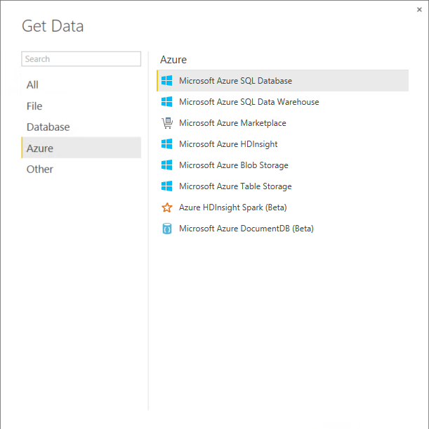
與 Azure 服務整合
Power BI Desktop
連接到不同的 Azure 服務，並且建立查詢
查詢可以與不同的資料來源進行整合，不一定要是 Azure
從 Power BI Desktop 檔案中取出的資料集也可以重新讀取

Slide 22
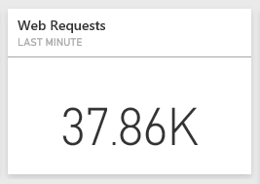
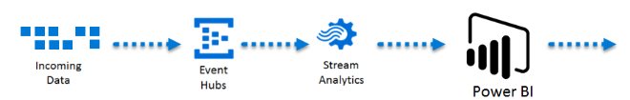
與 Azure 服務整合
透過 Azure Stream Analytics 做即時儀表板更新
Use Azure Stream Analytics to push live, streaming data to Power BI
Enables real-time dashboards at scale, over data from devices and applications
Can stream millions of events per second
Can perform aggregation over time windows
Tip: Use Q&A to ask: “Show Web Requests where Timestamp is last minute”

Slide 23
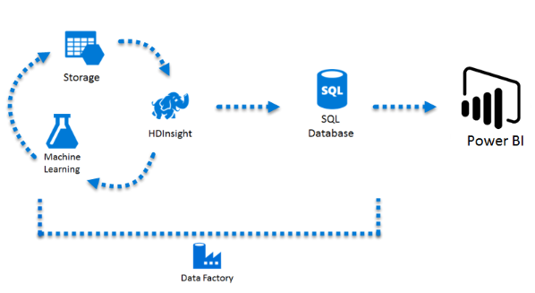
與 Azure 服務整合
進階分析操作
組合 Azure 服務來驅動進階資料分析:
Azure HDInsight: 處理大數據
Azure Machine Learning: 預測性分析
Azure Data Factory: 排程及延展

Slide 24
03 從資料集拉出報表
認識 Power BI Desktop
視覺化工具
上傳至 PowerBI.com
儀表板
Notes:
Introduce the module title and topics.
It is recommended that you become fully familiar with the module content by researching the topics at the Power BI knowledgebase: https://support.powerbi.com/knowledgebase - many links are provided in the presenter notes.

Slide 25
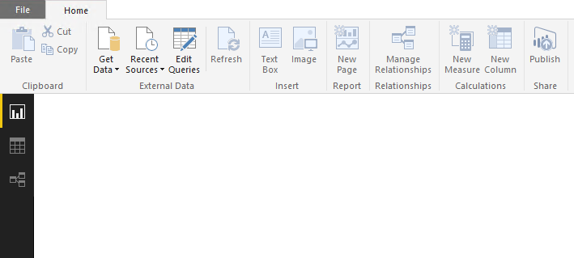
從 Power BI Desktop 開始
用戶操作: 取得資料
“取得資料 (getting data)” 被定義為一種查詢
資料來源包括檔案、資料庫、Azure 及其它
能簡單快速地以 “as is” 載入資料
基本操作: Select type ► Define connection ► Authenticate ► Load
Optionally, the Query Editor can be used to transform queries
Notes:
It all begins by connecting to, and retrieving, data.
Power BI knowledgebase: https://support.powerbi.com/knowledgebase/articles/471635-connect-to-data-in-power-bi-designer

Slide 26
從 Power BI Desktop 開始
用戶操作: 三種內容檢視
報表 檢視
資料 檢視
關聯 檢視
Notes:
The three views provide alternate user experiences to work with their model.

Slide 27
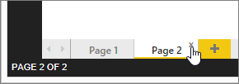
從 Power BI Desktop 開始
User experience: Report view
Work in Report View to create any number of report pages with visualizations
It provides almost the same design experience as the report Editing View in the Power BI service
A report will have at least one blank page to start, and any number of pages can be added
Pages appear, and can be managed, in the navigator pane
Notes:
Power BI knowledge base: https://support.powerbi.com/knowledgebase/articles/461283-report-view-in-power-bi-designer

Slide 28
Introducing Power BI Desktop
User experience: Report view: Continued
The intent of the application is to land the user on the report canvas as quickly as possible
Built-in intelligence will often infer relationships, and detect data types and categories
Evidence suggests that most schemas are relatively simple, and so the optimized path is: Load data ► Visualize
Many model transformations can be applied while working in Report View
Change data types, formats, calculation formulas
Rename fields
Sort columns
Manage relationships
Note: The versatility of Report View, and the immediate visualization of model transformations, is a strong competitive advantage over many other data analysis and reporting products
Notes:
Stress the messaging on this slide, in particular the note about competitor advantage.

Slide 29
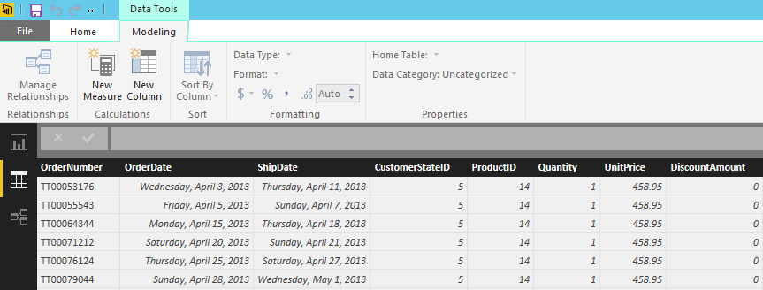
Introducing Power BI Desktop
User experience: Data view
Work in Data View to inspect, explore, and understand data in the model
It is a different experience from how you can view tables, columns, and data in Query Editor
This is a view of the data after it has been loaded into the model
Notes:
Power BI knowledgebase: https://support.powerbi.com/knowledgebase/articles/663202-data-view-in-power-bi-desktop

Slide 30
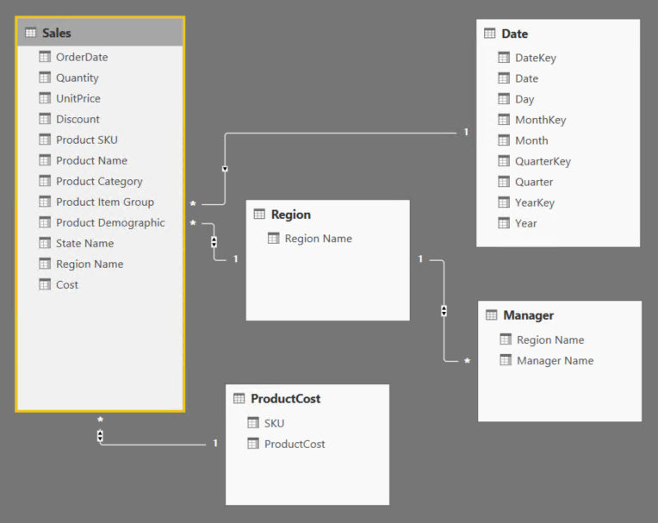
Introducing Power BI Desktop
User experience: Relationships view
Work in Relationships View to view all tables, columns, measures and relationships in the model
Notes:
Power BI knowledgebase: https://support.powerbi.com/knowledgebase/articles/663229-relationship-view-in-power-bi-desktop

Slide 31
Introducing Power BI Desktop
Complex schemas: Development methodology
In contrast to the simple and quick “get then visualize” approach, more complex schemas may follow this methodology:
Create queries and use the Query Editor to filter, cleanse and reshape data
Configure/refine relationships to establish the foundations of a model
Enrich the model with calculation logic and formatting
Design interactive reports with a broad range of modern data visualizations
Publish solutions directly to the Power BI service
Create queries
Configure relationships
Enhance the model
Design reports
Publish to Power BI

Slide 32
建立查詢
建立查詢
Configure relationships
Enhance the model
Design reports
Publish to Power BI
查詢能在載入模型前進行編輯
每個查詢一旦建立:
會以一個唯一的名稱對應它
Defines query steps by using the language “M”
Most query step logic does not require writing formulas
Advanced logic can be written, and even exposed as functions
用來載入資料到模型表中

Slide 33
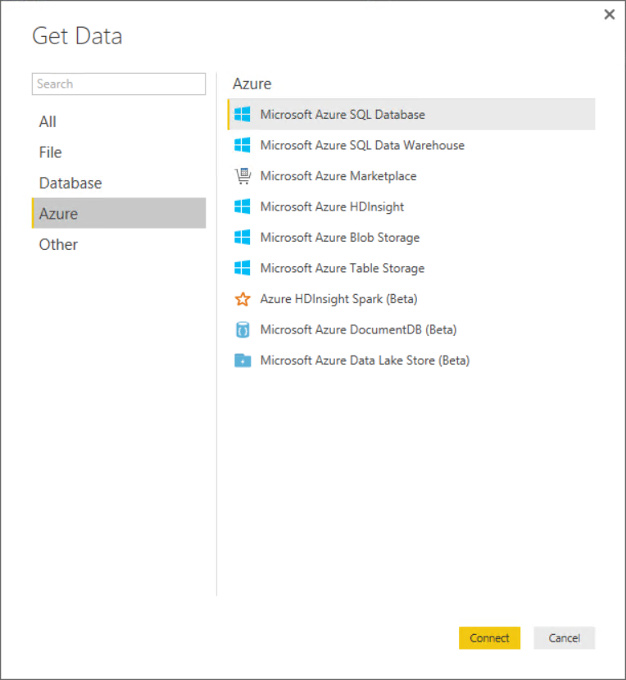
建立查詢
Source types: Azure

Slide 34
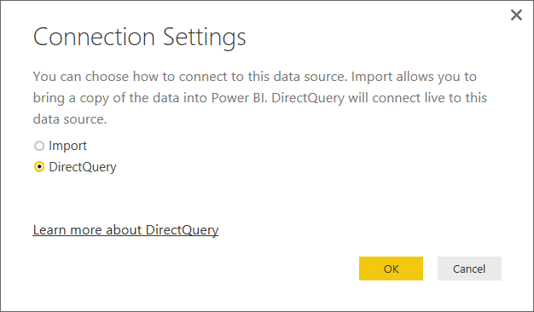
建立查詢
DirectQuery 模式
在支援的資料來源下，可以使用 DirectQuery 即時讀取資料
SQL Server
Azure SQL Database
Azure SQL Data Warehouse
SAP HANA

Slide 35
建立查詢
DirectQuery 模式 (Continued)
發佈至 Power BI 服務時:
Until credentials are supplied, opening a published report or exploring a dataset created with a DirectQuery connection to an Azure connection results in an error
For data sources other than Azure connections that use DirectQuery, an Enterprise Gateway must be installed and the data sources must be registered to establish a data connection
好處:
可以針對非常大量的資料做視覺化圖表
報表永遠呈現最新的資料

Slide 36
建立查詢
DirectQuery 模式 (Continued)
限制:
所有表格必須來自單一資料庫
The Query Editor query cannot be overly complex
There is no support for calculated columns or tables
Measures are restricted to a subset of the DAX functions
Relationship filtering is limited to a single direction, rather than both directions
The data type of a column cannot be changed

Slide 37
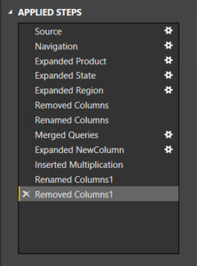
Creating queries
Defining query steps
The Query Editor can be used to filter, cleanse and reshape data into the desired result
Steps can easily be produced by applying column filters, and by using the commands available from the ribbon, or the query and column context menus
It is possible to select a step and preview the data at that step
Steps can be removed – but take care not to remove a step that downstream steps depend on
Step formulas can be viewed or edited in the formula bar

Slide 38
Creating queries
Defining query steps: Commands
Numerous commands are available on the Query Editor ribbons and context menus to:
Manage columns
Reduce rows, including removing errors
Transform
Split
Add columns, by using formulas
As the editor experience is WYSIWYG, users can easily experiment and roll-back changes

Slide 39
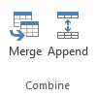
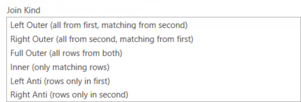
Creating queries
Defining query steps: Combining queries
New queries can be created by:
Merging two queries (joining on a common column)
Appending two queries (union)
Merge join options include:

Slide 40
Configuring relationships
Create queries
Configure relationships
Enhance the model
Design reports
Publish to Power BI
Relationships enable filters on one table to appropriately propagate filter to other tables
Note: Relationships are not foreign key (integrity) constraints
They can be defined between any two tables, regardless of their data connection or source type
However, they must be based on single columns with matching data types
There is no support for self-referencing relationships

Slide 41
Configuring relationships
Advanced options
It is possible to define multiple relationship paths between two tables
One relationship must be active, and will be used by default during model browsing
The remaining relationships are inactive, and can be used explicitly in model calculations

Slide 42
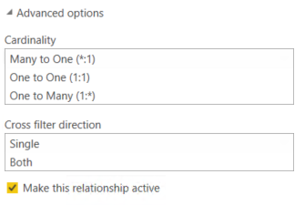
Configuring relationships
Advanced options: Continued
Configure relationship advanced options to set:
Cardinality
Cross filter direction
The Both option enables many-to-many analysis
Active/inactive
Tip: All options can be interpreted from symbols used in the relationship diagram

Slide 43
Enhancing the model
Create queries
Configure relationships
Enhance the model
Design reports
Publish to Power BI
Model tables can be extended with hierarchies, calculations, and may be hidden (i.e. not for reporting)
Model column properties can be set:
Data type
Format
Categorization
Spatial types, or web URLs
Sort order, based on another column from the same table
Default summarization (numeric, text and date columns)
Visibility

Slide 44
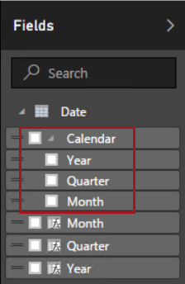
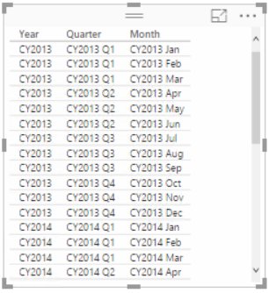
Enhancing the model
Hierarchies
Hierarchies can be added to a table, enabling navigation between columns (in the one-to-many direction)

Slide 45
Enhancing the model
Calculations
There are three different types of calculations, and each are defined by using DAX:
Calculated columns
Calculated tables
Measures
DAX = Data Analysis EXpressions (DAX), consisting of:
Excel functions (~80 functions)
Table functions
Aggregate functions
Relationship navigation functions
Context modification functions
Time Intelligence functions
Note: DAX theory is not covered in this training course

Slide 46
Enhancing the model
Calculations: Calculated columns
Define Calculated Columns to add new columns to tables (non-DirectQuery sources only)
Column values for each row are materialized and stored in the model
If possible, to reduce the model size, avoid creating them
Column values are recalculated when:
The table is refreshed
Formula dependencies are refreshed

Slide 47
Enhancing the model
Calculations: Calculated tables
Define Calculated Tables to add new tables to the model, based on existing data from other tables
Calculated tables are generally best for intermediate calculations of data stored in the model, rather than calculated on the fly
Calculated tables appear in Relationship view, and relationships can be defined with other tables
If possible, to reduce the model size, avoid creating them
Calculated tables are recalculated in the same circumstances as calculated columns
Note: This is an advanced design concept
Notes:
Power BI knowledgebase: https://support.powerbi.com/knowledgebase/articles/741510-calculated-tables-in-power-bi-desktop

Slide 48
Enhancing the model
Calculations: Measures
Define Measures to add aggregation logic to the model
Values are not materialized in the model
Formulas are evaluated at query time
Common aggregate functions:
Sum
Count, Distinct Count
Average
Minimum, Maximum
Note: Summarizable columns are aggregated by reports—so defining measures is not necessary for simple aggregation requirements

Slide 49
Enhancing the model
Tuning the model
The model design can be tuned to improve its usefulness and Q&A response accuracy
Set appropriate column data types, formats and categorization
Ensure relationships are configured
Ensure table and columns are visible/hidden
Ensure table, column and measure names are unique and concise

Slide 50
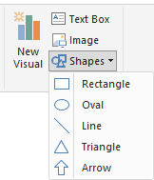
Designing reports
Create queries
Configure relationships
Enhance the model
Design reports
Publish to Power BI
Reports can be designed based on the visible model interface
The design experience is almost the same as is available in the Power BI online service
Text boxes, images and shapes can be added
Text boxes can contain hyperlinks

Slide 51
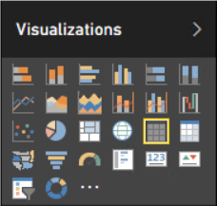
Designing reports
Custom visuals
Custom visuals can be imported to extend beyond the out-of-the-box visualizations
A gallery of visuals created by the Power BI community is available at https://app.powerbi.com/visuals
Browse through the visuals or submit one of your own for others to use
The list of available visuals is growing each month
Custom visuals will render in the Power BI service
Note: The topic of custom visual development is covered later in this training course

Slide 52
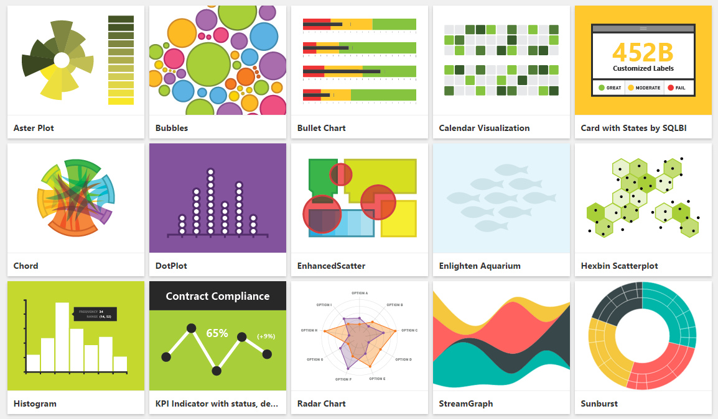
Designing reports
Custom visuals: Gallery (subset)
* And the list is growing!

Slide 53
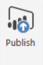
發佈至 Power BI
Create queries
Configure relationships
Enhance the model
Design reports
Publish to Power BI
The Power BI Desktop file can be uploaded to the Power BI service, or published directly
Note, if overwriting an existing dataset:
If there are two or more datasets with the same name, remove one, or rename the Power BI Desktop file
Renaming columns or measures can break existing reports or dashboard tiles

Slide 54
Describing additional capabilities
Additional capabilities:
Running R scripts (Preview)
Generating R visuals (Preview)

Slide 55
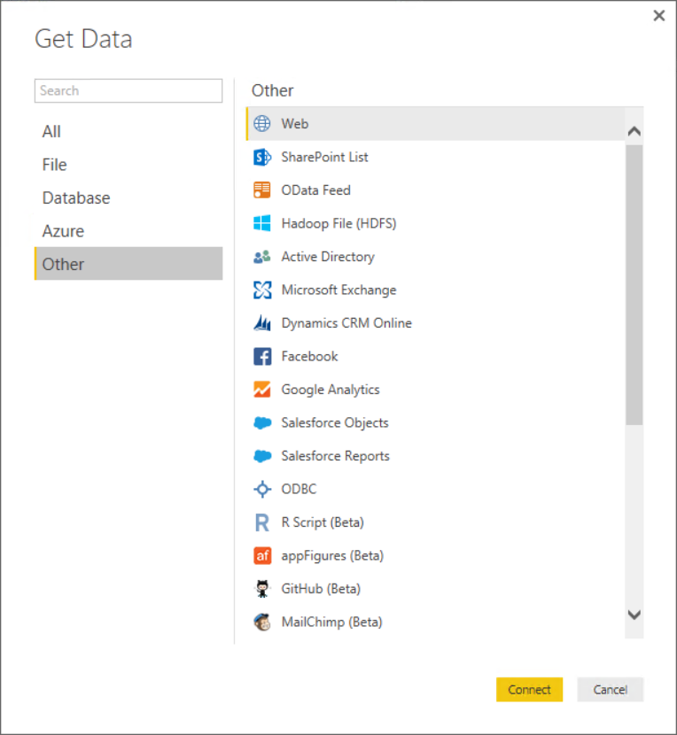
Describing additional capabilities
Running R scripts (Preview)
R scripts can be run directly in Power BI Desktop, and resulting datasets imported into a Power BI Desktop data model
R must be installed on the local machine
Only data frames are imported
Columns typed as Complex and Vector are not imported
Can be refreshed with the Gateway—Personal
Notes:
https://powerbi.microsoft.com/en-us/documentation/powerbi-desktop-r-scripts/

Slide 56
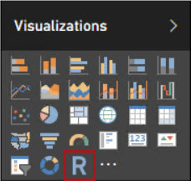
Describing additional capabilities
Generating R visuals (Preview)
R visuals render from R script, accepting input fields
Benefits:
Leverage the voluminous and growing number of out-of-the-box plots available in R
Easily customize R visuals by developing the script
Combine advanced analytics in visuals
Interact with R visuals in Power BI Desktop (filter, and cross-filter are supported)
Presently, R visuals are published to the Power BI service as snapshots
Live Power BI service rendering is planned
Note: This is a preview feature that requires enabling in Power BI Desktop Settings
Notes:
https://powerbi.microsoft.com/en-us/blog/announcing-preview-of-r-visuals-in-power-bi-desktop/

Slide 57
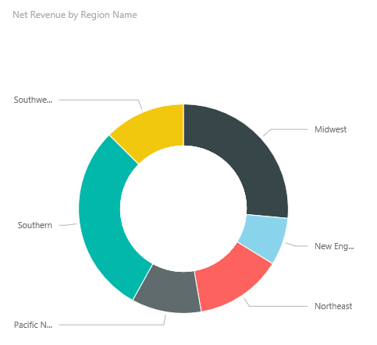
Creating and exploring reports
Creating reports
Use reports to layout visualizations across one or more pages
Rich, interactive reports can be created, updated and explored in the web browser experience
A report is based on a single dataset
Reports consist of one or more pages
Each page can be named, and consists of visualizations and shapes
Notes:
Power BI Knowledgebase: https://support.powerbi.com/knowledgebase/topics/65160-visualizations-in-reports

Slide 58
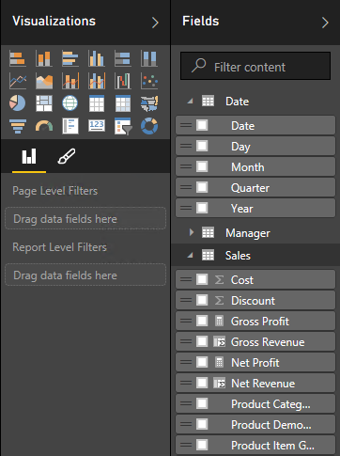
Creating and exploring reports
Creating reports
Dataset fields are used to layout a visualization
Visualization type and format can be adjusted to suit
Filtering can be applied at report, page or visualization level
Sorting can be set at visualization level

Slide 59
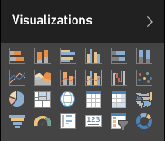
Creating and exploring reports
Creating reports: Visualization types
Choose from numerous modern visualization types:
Filter data:
Slicer
Display numeric values:
Card, Multi Row Card, Table, Matrix
Graphically visualize data:
Bar, Column, Line, Combo, Scatter, Waterfall, Pie, Donut, Funnel, Treemap, Gauge
Spatially visualize data:
Map, Filled map
Import custom visuals
Tip: Hover the cursor of each icon to reveal a tooltip description of the visualization type
Custom visuals are covered later in this training course

Slide 60
Creating and exploring reports
Exploring reports
Reports are either in Reading View or Editing View
In both views, report pages can be opened in Full Screen Mode, or individual visualizations can be popped out/in to see them zoomed in/out
In Reading View:
Users cannot change the report definition
Users can interact by changing filters or sorting
Users can highlight values in one visualization to filter other page visualizations
Shared reports can only be opened in Reading View
In Editing View:
Users can interact, as in Reading View
Users can also update the report (add/remove/reorder pages or visualizations)

Slide 61
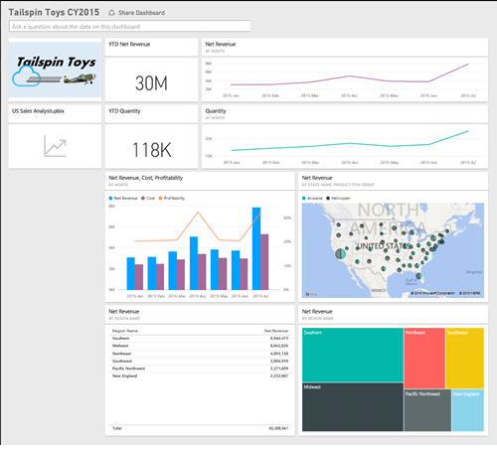
Assembling dashboards
Dashboards display tiles in a single canvas
A tile is sourced by “pinning” either a report, report visualization, or a Q&A response
A dashboard can be based on one or more datasets
Tiles can be resized and repositioned, and their titles/subtitles can be updated
Tiles can be sized to 1-5 units wide/high
Notes:
Power BI Knowledgebase: https://support.powerbi.com/knowledgebase/topics/65158-all-about-dashboards

Slide 62
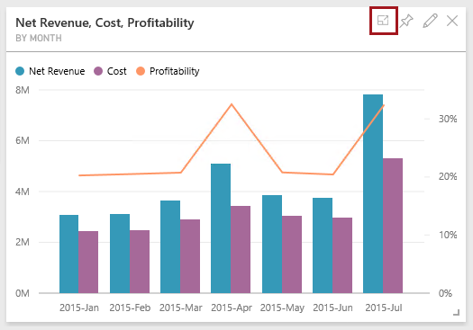
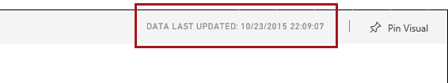
Assembling dashboards
Continued
Tiles can be opened in In-Focus Mode, filling the dashboard space
The data last updated date is displayed
Not available for tiles sourced from Q&A questions
Data can also be exported
Notes:
Power BI Knowledgebase: https://support.powerbi.com/knowledgebase/topics/65158-all-about-dashboards

Slide 63
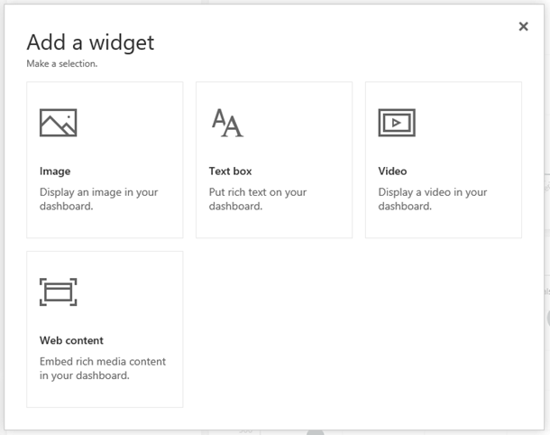
Assembling dashboards
Continued
Additionally, widgets can be added to a dashboard, using
Images
Text boxes
Videos
Web content
Notes:
Power BI Knowledgebase: https://support.powerbi.com/knowledgebase/topics/65158-all-about-dashboards

Slide 64
Assembling dashboards
Continued
Dashboards enable interactivity
By default, clicking on a tile will drill through to its source
However, a custom link (URL) can be set to override this default behaviour
Dashboard tiles can reflect live, real-time data
For non real-time datasets, tile thumbnails are automatically cached every 15 minutes
Dashboards can be displayed in Full Screen Mode
Additionally, all tiles can be displayed by using Fit to Screen
Note: Live dashboards can be achieved with Azure Stream Analytics integration or the Power BI REST API. Both topics are covered later in this course.

Slide 65
04 開發及擴充 Power BI
Extending Power BI
Power BI REST API
Custom visuals
Notes:
Introduce the module title and topics.
It is recommended that you become fully familiar with the module content by researching the topics at the Power BI knowledgebase: https://support.powerbi.com/knowledgebase - many links are provided in the presenter notes.

Slide 66
擴充 Power BI
開發人員有下列幾種方式可以加強或客製化 Power BI 的功能及使用體驗
Power BI REST API
自訂視覺化元件
將 Power BI 整合進應用程式中

Slide 67
Power BI REST API
在應用程式中使用 Power BI REST API 直接把資料推送到 Power BI 資料集
Client application
Web application
透過程式管理資源
Datasets
Tables
儀表板會在資料載入時即時更新
No more waiting, or needing to press the Refresh button! ☺
Notes:
Power BI Knowledgebase: https://powerbi.microsoft.com/developers

Slide 68

Power BI REST API
Object model hierarchy
一個 Power BI 容器可以有多組資料集，每個資料集會有獨一無二的 GUID 作識別
A dataset can:
Be owned by a user or a group
Have multiple tables, which are referenced by name
A table has multiple rows
Power BI
Datasets
Tables
Rows

Slide 69
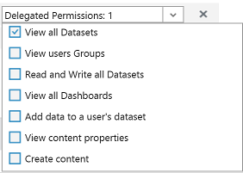
Power BI REST API
Authentication
An application must be registered, and is required to establish an identity for the application
Applications are identified by their Client ID
Permissions are delegated to the Power BI service
REST API calls are made on behalf of an authenticated user by passing a token in the “Authorization” header

Slide 70
Power BI REST API
Application registration
An application can be registered with
Power BI App Registration Tool at http://dev.powerbi.com/apps, or
Azure Management Portal
The Power BI App Registration Tool is the easiest option since there are just a few fields to fill in
If you want to make changes to you app, this can only be done through the Azure Management Portal

Slide 71
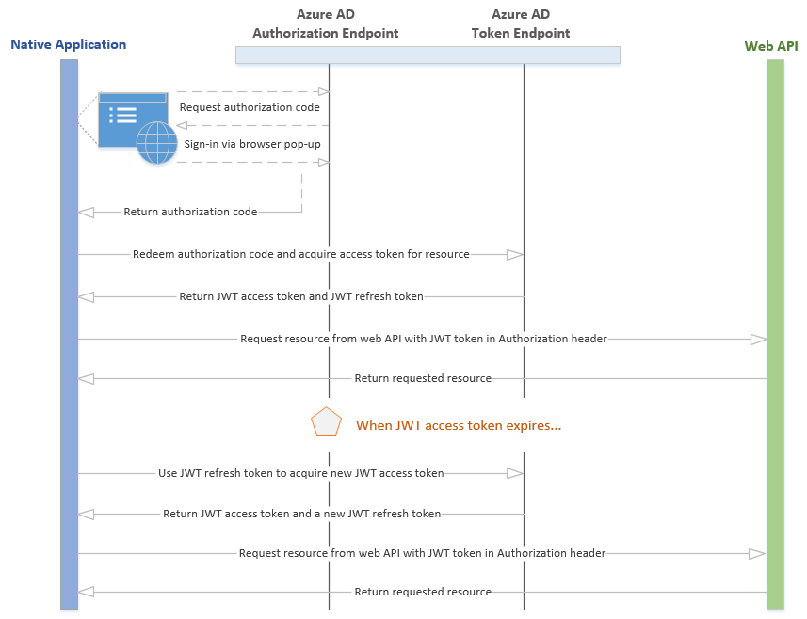
Power BI REST API
Authentication flow: Client application

Slide 72
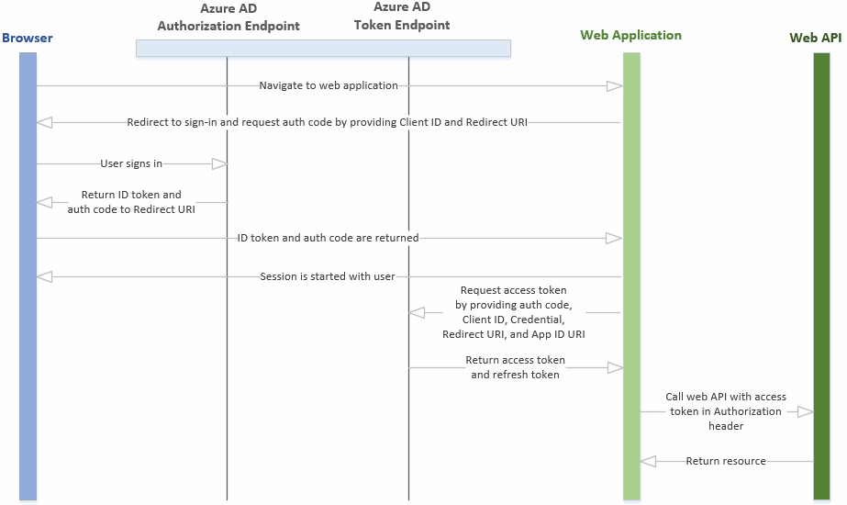
Power BI REST API
Authentication flow: Web application

Slide 73
Power BI REST API
Operations
Operation | Method
List all datasets | GET | Returns a JSON list of all dataset objects that includes a name and dataset ID
Create a dataset | POST | Creates a new dataset with the schema definition that is in the JSON body, and returns the dataset ID and the properties of the objects created
List all tables | GET | Returns a JSON list of tables for the specified dataset
Update an existing table schema | PUT
Add rows to a table in a dataset | POST
Clear the rows in a table | DELETE
List all groups | GET | Returns a JSON list of all the groups of which the user is a member
List all dashboards | GET | (In preview)
List all tiles | GET | (In preview) Returns a JSON list of tiles for the specified dashboard. Use this method to retrieve the embed URL.
List all reports | GET | (In preview) Use this method to retrieve the embed URL
Notes:
Useful link: http://docs.powerbi.apiary.io/#

Slide 74
Power BI REST API
Example: List all datasets
Request
GET https://api.powerbi.com/v1.0/myorg/datasets HTTP/1.1 Authorization: Bearer {AAD Token} Content-Type: application/json; charset=utf-8
Response
{ "datasets": [ { "id": "2C0CCF12-A369-4985-A643-0995C249D5B9", "name": "Music" }, { "id": "C446840B-94AD-4B23-8896-C276E69B8FAA", "name": "SalesMarketing" } ] }

Slide 75
Power BI REST API
Example: Add a row to a table in a dataset
Request
POST https://api.powerbi.com/v1.0/myorg/datasets/2C0CCF12-A369-4985-A643-0995C249D5B9 /Tables/Product/Rows HTTP/1.1 Authorization: Bearer {AAD Token} Content-Type: application/json; charset=utf-8 { "rows": [ { "ProductID":1, "Name":"Adjustable Race", "Category":"Components", "IsCompete":true, "ManufacturedOn":"07/30/2014" } ] }

Slide 76
Power BI REST API
Restrictions
Maximum rows per single push: 10K
Note that ingestion rates are restricted by license:
Power BI license: 10K rows/hour
Power BI Pro license : 1M rows/hour
Maximum rows per table: 5M
A dataset is defined with a retention policy:
none: Rows will be collected to the limit
basicFIFO: Will keep up to 200K rows, and remove the oldest rows as new rows are added
Maximum pending requests: 5

Slide 77
Integrate Power BI
Integrate a Power BI tile or report into an app with an IFrame HTML element
For example, create a custom mobile app to display real-time Power BI tiles and reports on the user’s mobile device
Use the REST API to retrieve the embed URL
Once embedded, a click event handler can be added to enable navigation to the dashboard
This capability is presently in preview
Notes:
Useful link: https://powerbi.microsoft.com/custom-visuals

Slide 78
Custom visuals
Developers can develop custom visuals for use in Power BI solutions
To help developers get started, Microsoft has published the code for all of their visualizations
This is all available as an open source project on GitHub
The project contains over 20 visualization types, the framework to run them, and the testing infrastructure that enables you to build high quality visualizations
The framework provides all the interfaces required to integrate fully with Power BI's selection, filtering, and other UI experiences
Developers are encouraged to submit their custom visuals to the Power BI Visuals Gallery for sharing with the Power BI community
Notes:
Useful link: https://powerbi.microsoft.com/custom-visuals

Slide 79
05 Power BI Embedded
Power BI Embedded
Power BI Embedded API
Notes:
Introduce the module title and topics.
It is recommended that you become fully familiar with the module content by researching the topics at the Power BI knowledgebase: https://support.powerbi.com/knowledgebase - many links are provided in the presenter notes.

Slide 80
輕鬆嵌入視覺化圖表
適用於任何裝置、迅速提升價值
輕鬆在您的應用程式中，透過 REST APIs 以及 Power BI SDK 內嵌互動式視覺化圖表
確保在跨裝置間一致性、不失真的資料體驗
提供順暢的身份驗證與授權流程
Realize faster time-to-value without redesigning your app

Slide 81
Power BI Embedded 定位
您的應用程式
Azure 資料服務
資料儲存
資料分析
物聯網
存取控制
SQL DB
Document DB
Blob Storage
StorSimple
SQL Data Warehouse
Power BI Embedded
Data Lake Analytics
Data Lake Store
HDInsight
Stream Analytics
IoT Hub
Event Hubs
Machine Learning
Notification Hubs
Azure Active Directory
Multi-factor authentication

Slide 82
Power BI Embedded API 架構
Your app
Power BI APIs
Discovery: Enumerate datasets and reports
Content Creation: Provision datasets and reports
Embed: Embed reports
Utility: Set connection strings and credentials
Programmatic
REST APIs
Azure Resource Manager API
Azure APIs for automation
Microsoft Azure
Power BI Embedded
Platform
Provision workspace collections
De-provision workspace collections
Manage API keys
Azure SQL Database
Azure SQL Data Warehouse
Spark on Azure HDInsight
Data

Slide 83



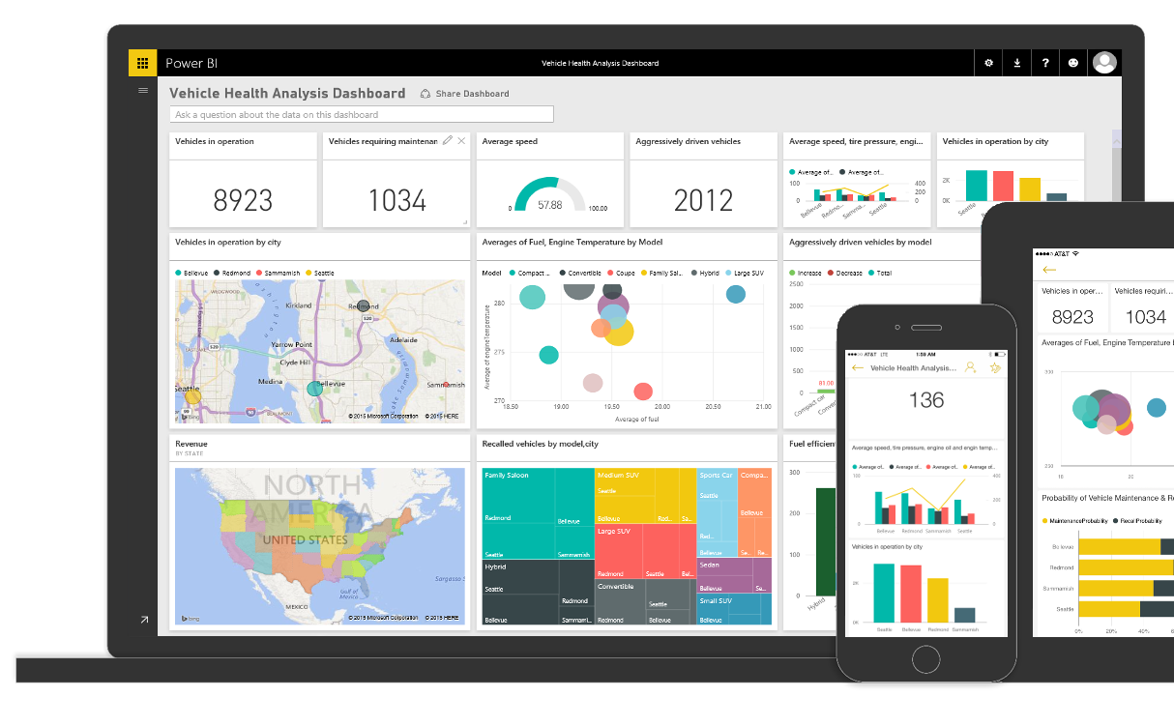
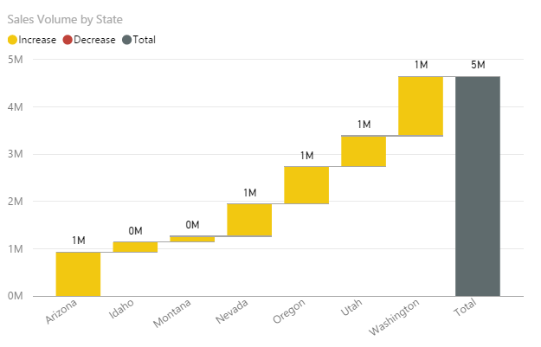



確保跨裝置體驗一致性
高品質、響應式的視覺化體驗，並且使用開放技術

Slide 84
Provide seamless authentication experiences
Application
Power BI
Users
Workspace
Auth. providers
Token
+ Claim: Can view Report 1
+ Expiration: 5 minutes
Report 1
Permissions
Report 2
Sign token
API keys
API keys
Copy API keys to your application
Create
Embed
Deploy

Slide 85
Provide seamless authentication experiences
Application
Power BI
User requests to view Report 1
Users
Workspace
Auth. providers
Token
+ Claim: Can view Report 1
+ Expiration: 5 minutes
Report 1
Permissions
Report 2
Validate token
API keys
API keys
Create
Embed
Deploy

Slide 86
Provide seamless authentication experiences
Application
Power BI
Users
Workspace
Auth. providers
Report 1
Report 1
Permissions
Report 2
API keys
API keys
Create
Embed
Deploy

Slide 87

Manage in a familiar environment—Azure
1,N
Microsoft Azure subscription
Developer
1,N
Workspace collection
Name
Admin Users
Endpoints
Keys
Gateways
Credentials
Geo Location
Tags
Azure SQL Database
Manually or programmatically provision workspaces
Create datasets and reports
Embed reports in your app
Control refresh behavior and credentials
Azure SQL Data Warehouse
1,N
on Azure HDInsight
Workspace
Name
Reports
Datasets
Tags
Embed
Your app
End users
Notes:
As a matter of principle, we will dock to existing concepts in Power BI as far as infrastructure/tenancy model, etc.
The primary concept in Power BI PaaS is “workspace”
At a high level, developers can:
Provision workspaces (manually or programmatically)
Create datasets, reports.
Embed reports
Control refresh behavior, creds, …

Slide 88
隨用即付, 依照 session 數計價
每個月根據 session 計費
0-100 | 免費
100+ | $0.05/session
使用 Power BI Desktop 操作報表 完全免費
計算成本更輕鬆直覺
Session 如何計算?
當用戶讀取報表時會註冊一個 session，這個 session 60 分鐘有效。
Query
Your data
Your users
Cache
Notes:
Rendered content is cached to reduce queries
User filtering may constitute a new render
App owners control what can be queried

Slide 89

今天就開始使用 PowerBI.com

Slide 90
相關 Power BI 開發參考資源
Power BI Embedded
https://azure.microsoft.com/services/power-bi-embedded
Power BI 開發中心
http://dev.powerbi.com
Power BI 開發部落格
http://blogs.msdn.com/powerbidev
範例程式碼
http://github.com/PowerBI
Power BI Embedded Explorer
https://github.com/Microsoft-DXTW/Power-BI-Embedded-Explorer
Visuals gallery
http://visuals.powerbi.com
發問
http://stackoverflow.com/questions/tagged/powerbi

Slide 91
Notes:
Thank you for attending this training!

